Slide 1
Two-Dimensional supersolidity in a dipolar quantum gas
11.09.2021
Wir präsentieren paper für fortbildungszwecke - gruppe

Slide 2
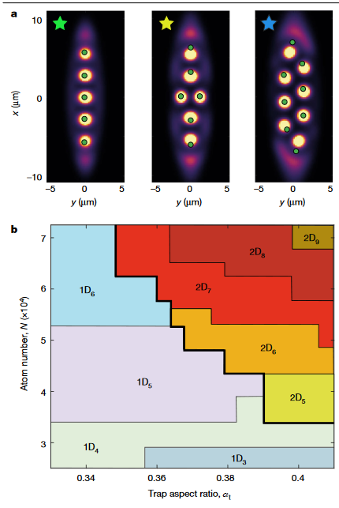
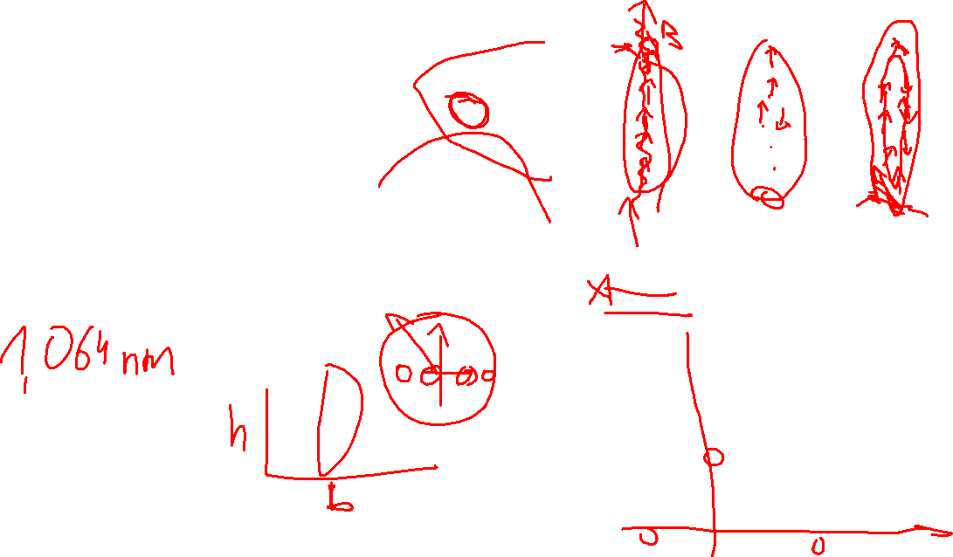
What is this about?
Solid droplets
Trapped dipoles
Depending on trap ratio transition between 1D and 2D droplets
Description of experimental finding with eGPE

Slide 3
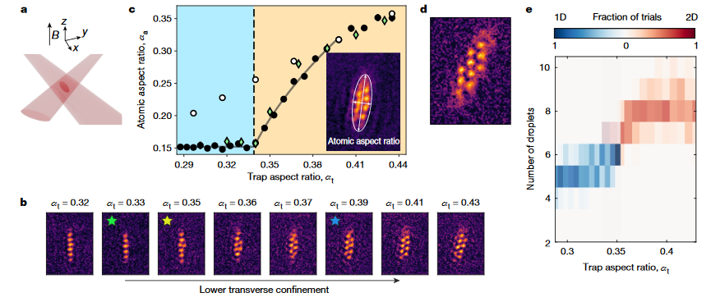
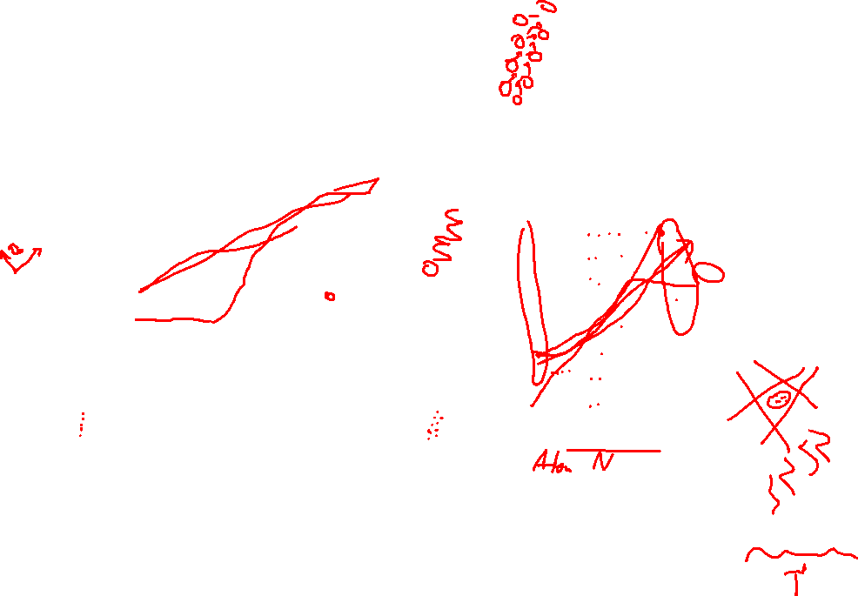
Whats Happening?
Optical trap = laser crossection (?)
Vary trap aspect ratio with laser frequency (?)
Observe transition between 1D and 2D droplets
1D linear structure, 2D ZigZag structure
Repeat multiple times for each aspect ratio (avg. 23)

Slide 4
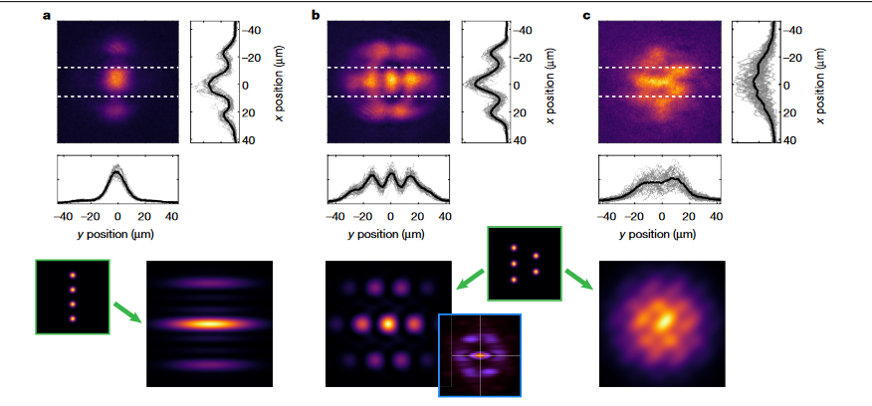
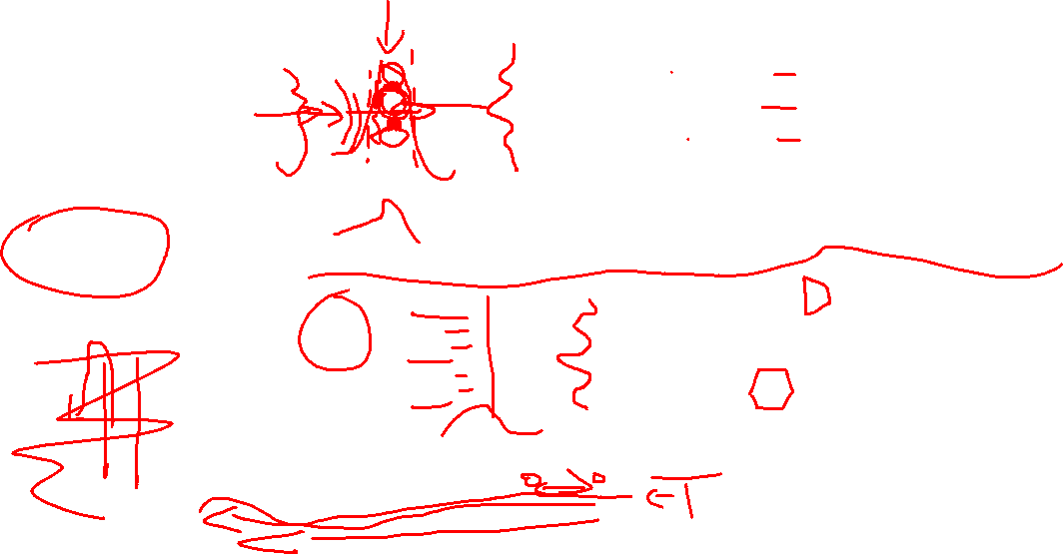
Supersolidity
Both crystalline properties and superfluid properties
  Local high density due to crystal lattice
  Coherence of this lattice due to superfluidity (?)
Matter-Wave interference
  2-slit experiment (?)
Only coherent droplets scatter (why?)

Slide 5
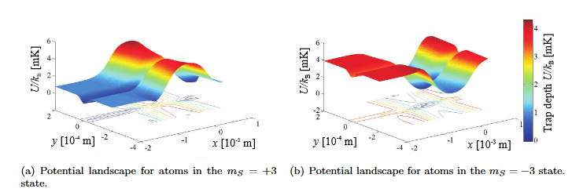
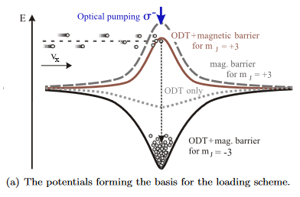
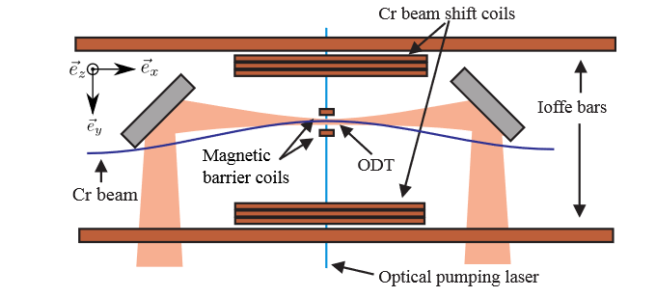
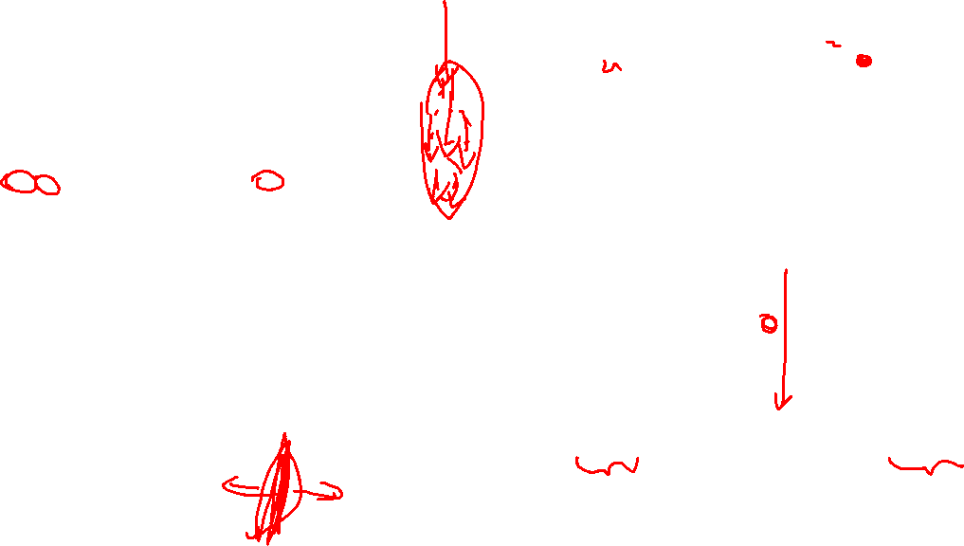
ODT
https://www.pi5.uni-stuttgart.de/documents/abgeschlossene-arbeiten/2011-Gorniaczyk-Hannes-A-Crossed-Optical-Dipole-Trap-Diplom.pdf

